Slide 1


KEB Hana Bank
Mobile application’s redesign
Javokhir Nazarov
User Experience and Design

Slide 2
Outline
Original app overview
User Context
User Experience
Prototyping with Cognitive Walkthrough
Evaluation
User Experience
Material Design principles
Conclusion

Slide 3

ORIGINAL APP OVERVIEW

Slide 4





User Context
PHYSICAL ENVIRONMENT
Ensure safe operation of smartphone.
Humidity: 30 to 50%
Temperature: from –20°C to 60°C
SOCIAL ENVIRONMENT
South Korea (for the full functionality).
USER
Foreigner with HANA Bank account.
Average smartphone user.
Age: from 18 to 65.
TASKS
Authorization
Balance inquiry
History
Transactions
TECHNICAL ENVIRONMENT
Smartphone*.
Android OS 7+.
iOS 10+.
Network connection.
*More than 70% of smartphones have biometrics sensors.

Slide 5
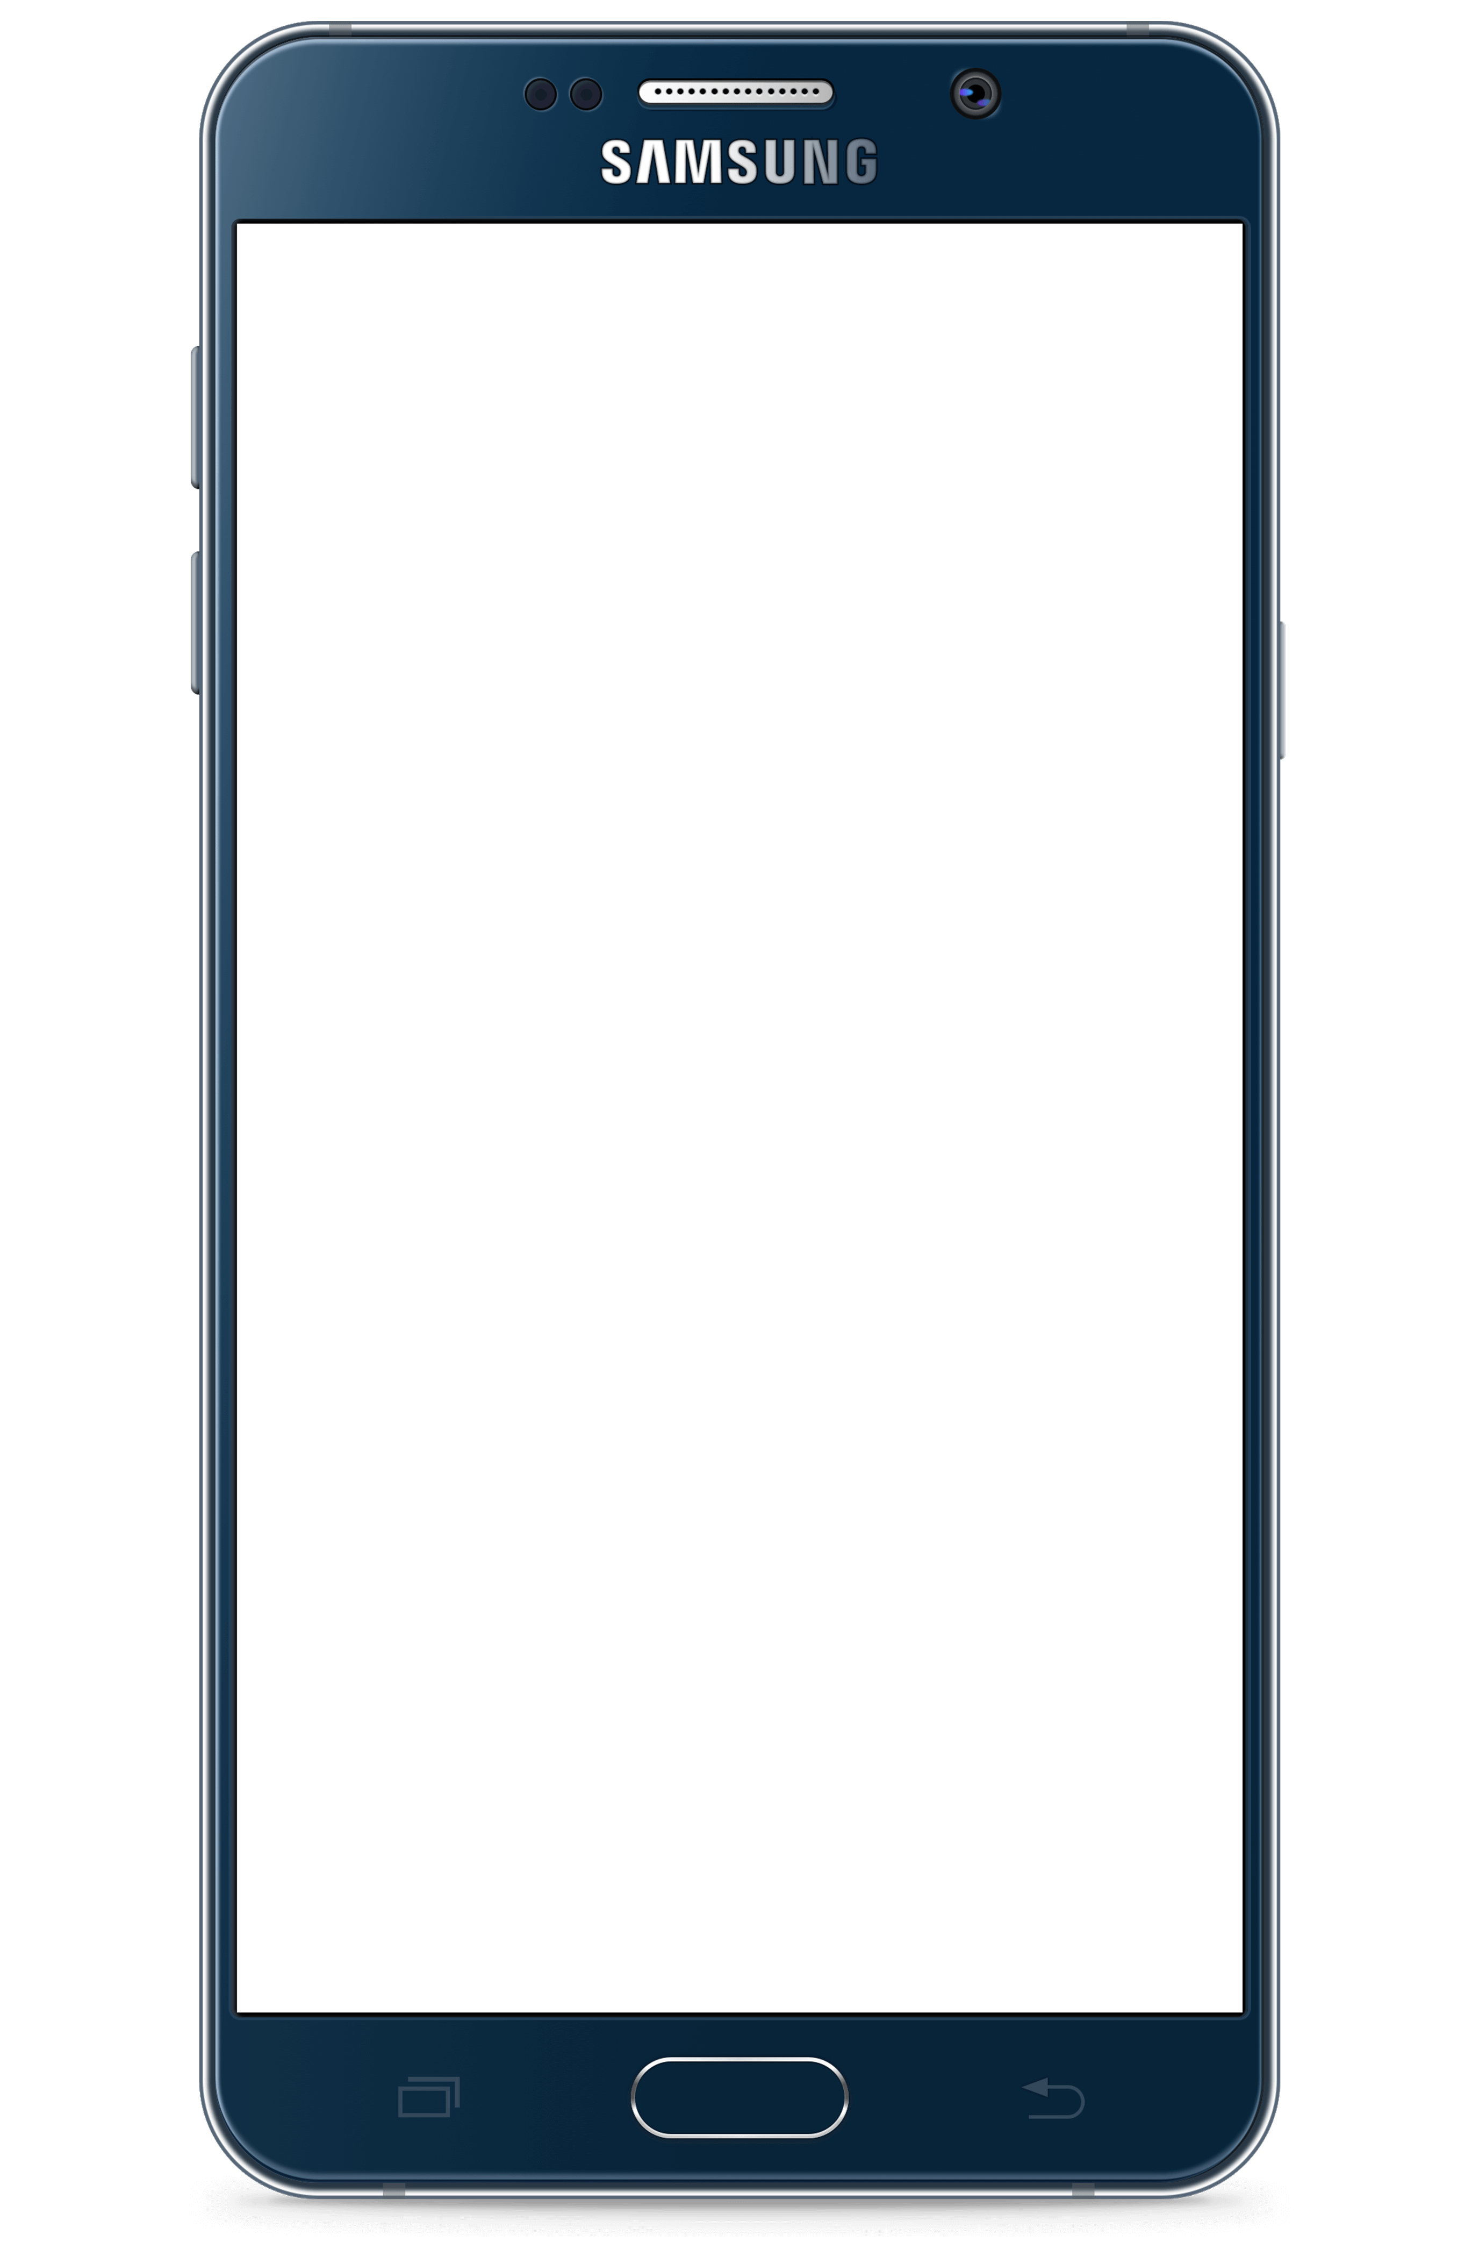
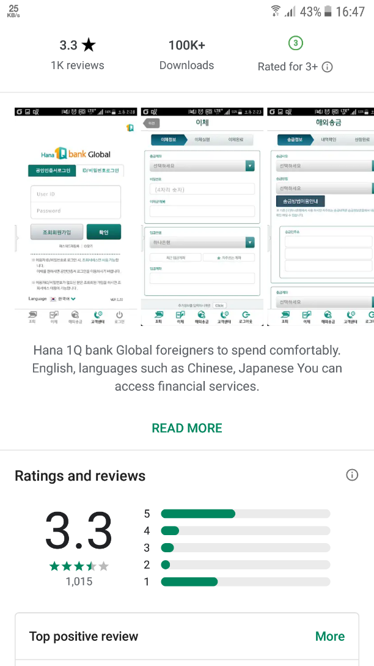
User Experience
✔
Practicality
Is the product useful to the user?
Usability
Is the product easy and intuitive to use?
Availability
Is the product accessible for all people?
Aesthetics
Visual attractiveness of a product
Offline issues
Help available outside the application
✘
✘
✘
✔
Notes:
Does it have a purpose that the user accepts? Does the product meet the needs of the user?
Does the user like the way that this product looks and feels?
In terms of Design, it however refers to the characteristic that products, services, and facilities can be independently used by people with a variety of disabilities.

Slide 6

PROTOTYPING WITH COGNITIVE WALKTHROUGH

Slide 7
Cognitive Walkthrough
Task:
Check HANA balance and transaction history
Steps:
Authorize
See the balance
Enter the “transaction history” section

Slide 8
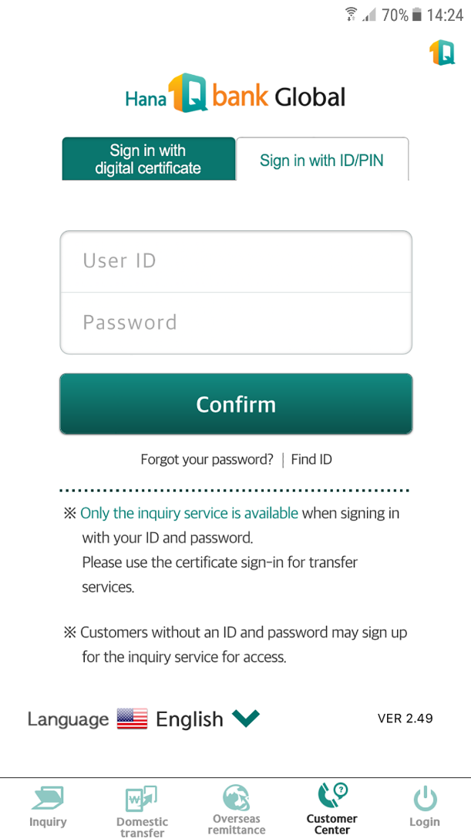
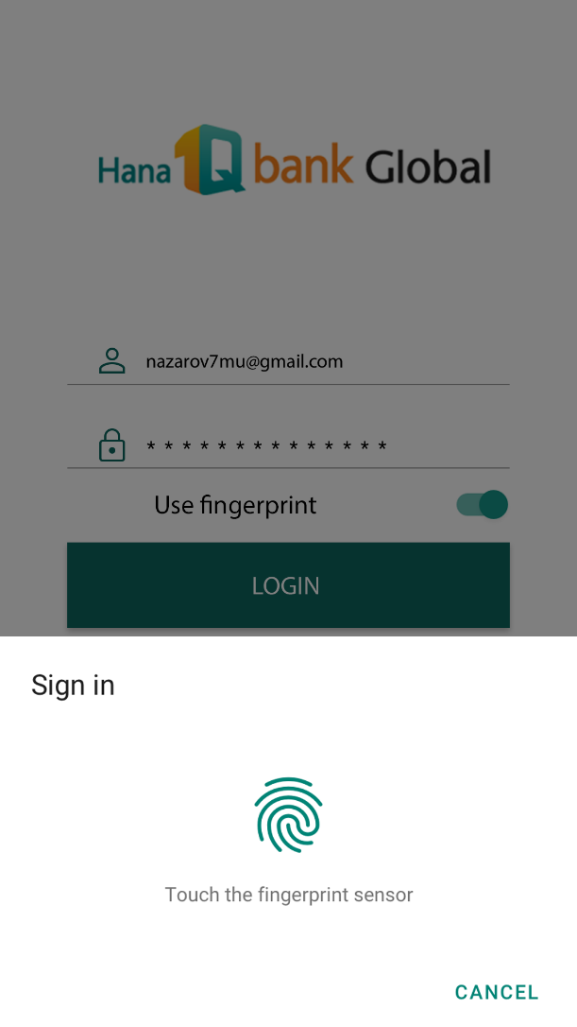
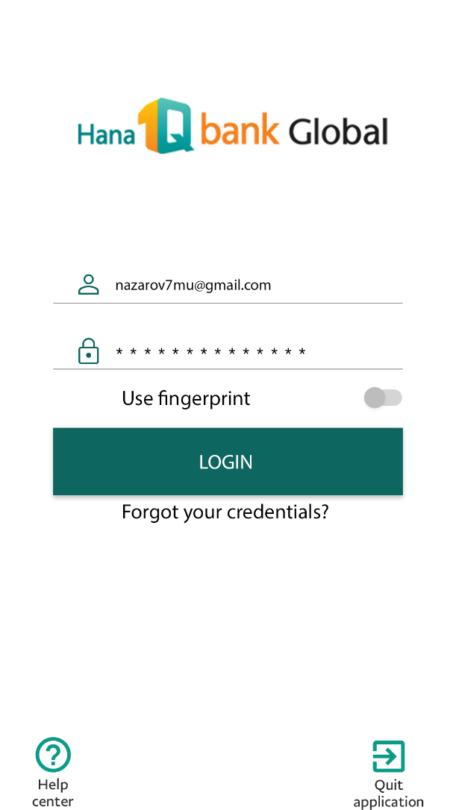
Step 1: Authorize
Thoughts:
I see irrelevant menu items that I cannot use
I want to use my fingerprint to log in
Recommendations:
Remove unnecessary buttons
Add biometric authentication method
Notes:
Fingerprint will make life easier everywhere we need digital certificate

Slide 9
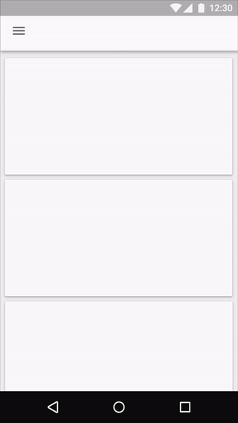
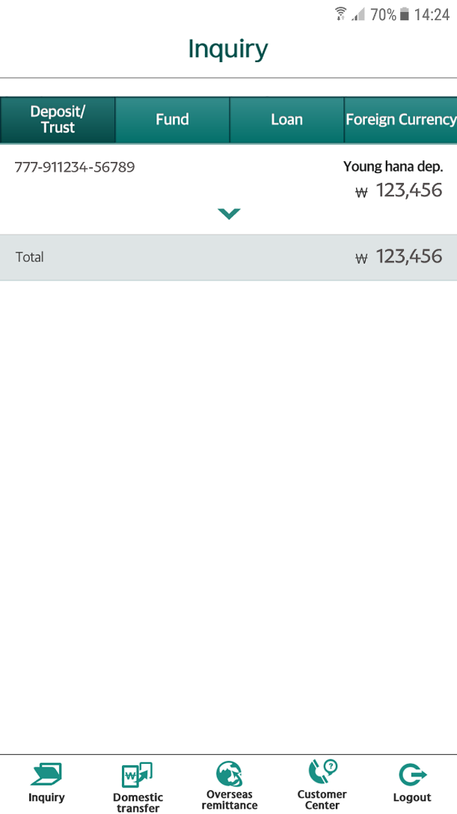
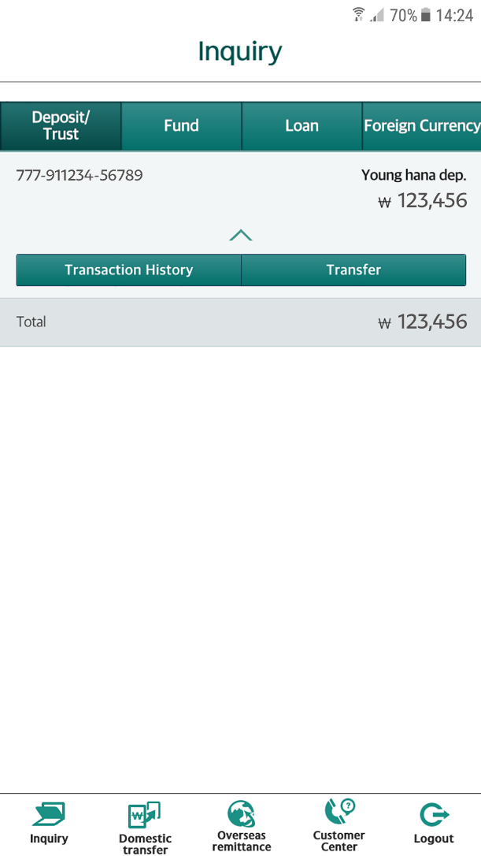
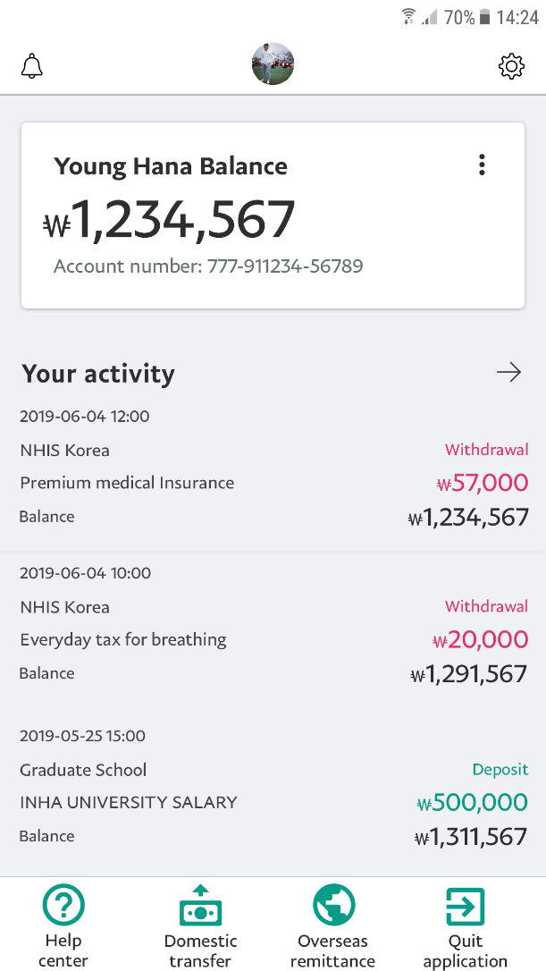
Step 2: Balance
Thoughts:
I cannot update balance
I cannot find transaction history section
Action:
I click on an arrow and finally see it
Recommendations:
Add ‘pull to refresh’ function to update balance
Add ‘recent transactions’ to utilize empty space
Provide easier way to access transaction history

Slide 10
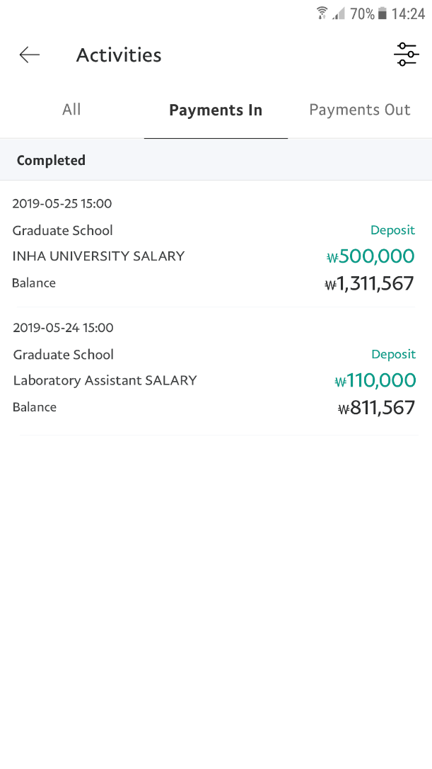
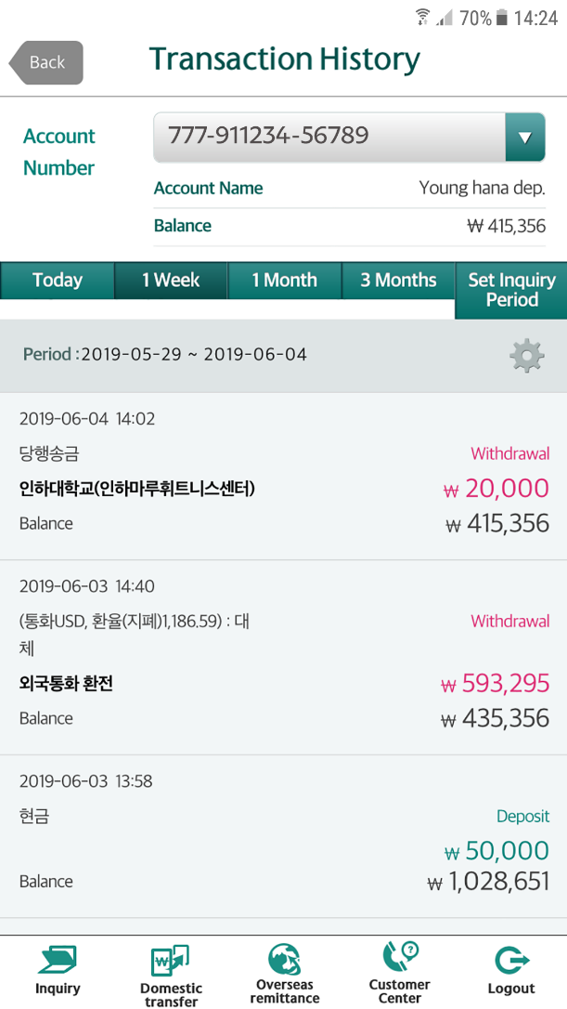
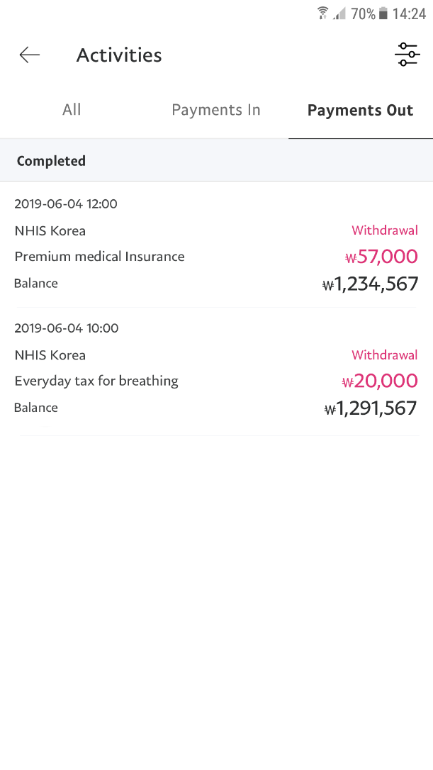
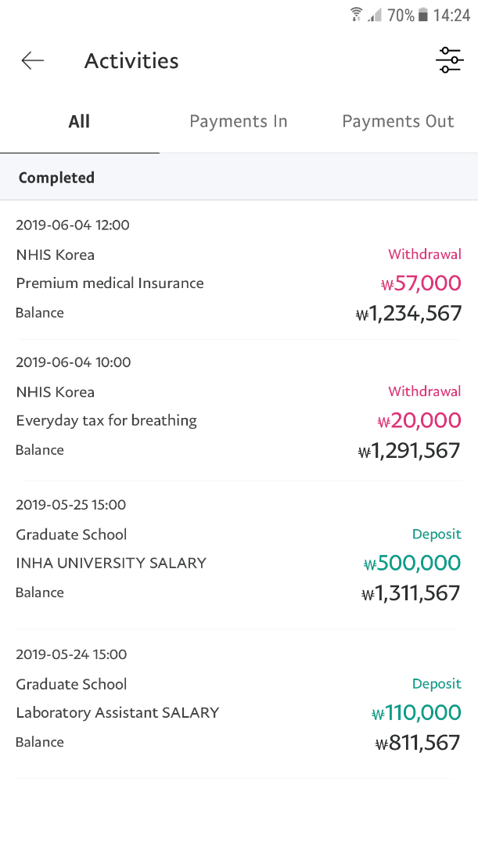
Step 3: Transaction history
Thoughts:
I see all recent transactions and filtering opportunities
Everything is understandable but messy
Also, it would be great to sort incoming and outgoing transactions
Recommendations:
Make the look more clean
Sort transactions

Slide 11

EVALUATION

Slide 12


User Experience
✔
Practicality
Is the product useful to the user?
Usability
Is the product easy and intuitive to use?
Availability
Is the product accessible for all people?
Aesthetics
Visual attractiveness of a product
Offline issues
Help available outside the application
✔
✘
✔
✔

Slide 13
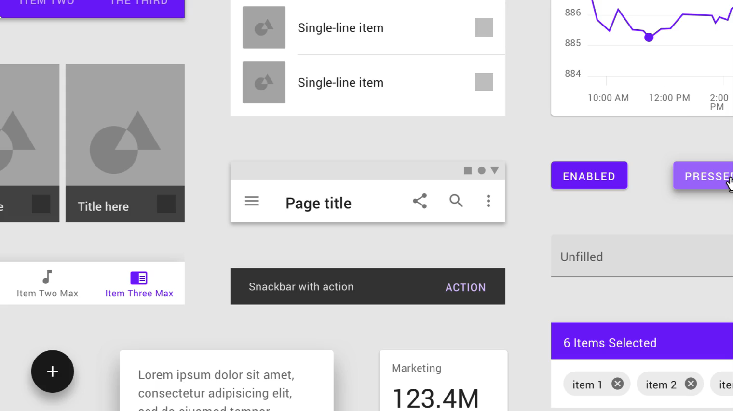
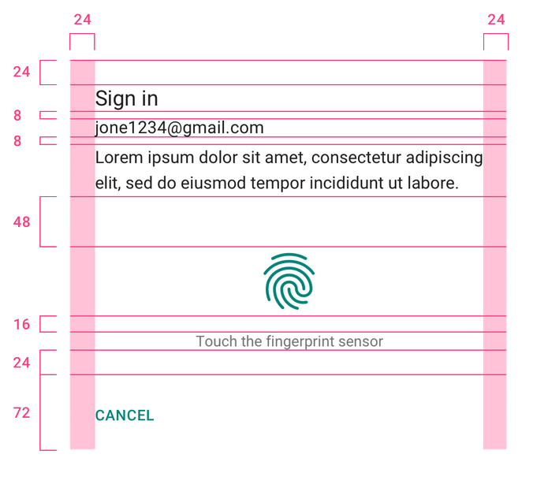

Material Design
Material design is a comprehensive guide for visual, motion, and interaction design across platforms and devices.
Adaptable system of guidelines, components, and tools that support the best practices of user interface design.
Notes:
Backed by open-source code, Material streamlines collaboration between designers and developers, and helps teams quickly build beautiful products.

Slide 14

Material Design
Primary and a secondary color are typically selected to represent your brand.
Сolor theme is harmonious, ensures accessible text, and distinguishes UI elements.
System icons are designed to be simple, modern and friendly. Each icon is reduced to its minimal form, expressing essential characteristics.
Notes:
Backed by open-source code, Material streamlines collaboration between designers and developers, and helps teams quickly build beautiful products.

Slide 15

CONCLUSION

Slide 16





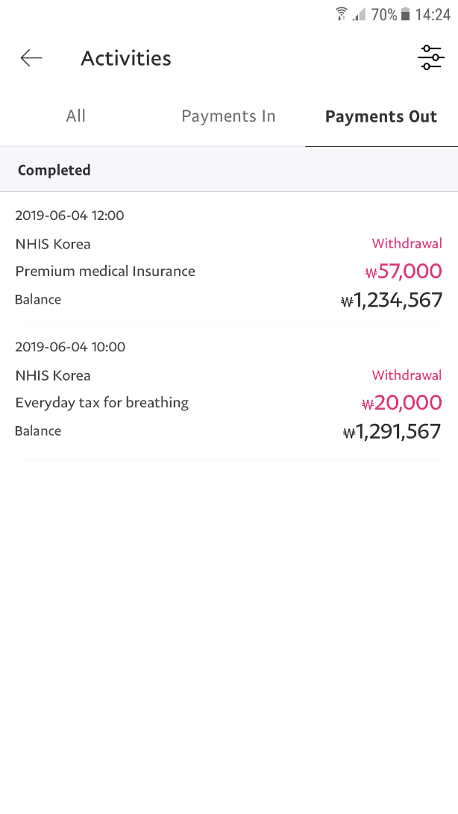

Summary
Took the benefits of the User Context’s
TECHNICAL ENVIRONMENT
Improved usability based on
COGNITIVE WALKTHROUGH
Improved aesthetics based on
MATERIAL DESIGN PRINCIPLES

Slide 17
References
https://www.androidauthority.com/2018-smartphones-fingerprint-sensors-803905/
https://www.quora.com/What-is-a-normal-temperature-limit-for-the-cell-phone-battery
https://www.brighthubengineering.com/hvac/81719-best-indoor-humidity-range-for-people-books-and-electronics/
https://material.io/
https://material.io/design/platform-guidance/android-fingerprint.html
https://materialdoc.com/components/selection-controls/

Slide 18

THANK YOU! Q&A

